Slide 1
11-12. Arrays
[ECE20016/ITP20003] Java Programming
Notes:
‹#›

Slide 2
Agenda
Array Basics
Arrays in Classes and Methods
Sorting Arrays
Multidimensional Arrays

Slide 3
Creating and Accessing Arrays
An array is a special kind of an object
Think of as collection of variables of same type
Syntax for declaring an array with new operator
Base_Type[ ] Array_Name = new Base_Type[Length];
(Base_Type Array_Name[ ] = new Base_Type[Length]; is also OK.)
Ex) double [ ] temperature = new double [7];
To access an element use
The name of the array + an index number enclosed in braces
Ex) temperature[5];

Slide 4
Square Brackets with Arrays
With a data type when declaring an array int [ ] pressure;
To enclose an integer expression to declare the length of the array pressure = new int [100];
To name an indexed value of the array pressure[3] = keyboard.nextInt();

Slide 5
The Instance Variable length
As an object, an array has only one public instance variable
Variable length
Contains number of elements in the array
It is final, value cannot be changed

Slide 6
Array Indices
Index of first array element is 0
Last valid Index is arrayName.length – 1
Array indices must be within bounds to be valid
When program tries to access outside bounds, run time error occurs

Slide 7
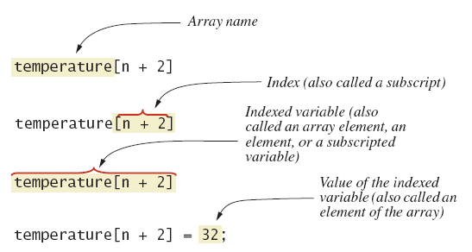
Array Details
Array terminology

Slide 8
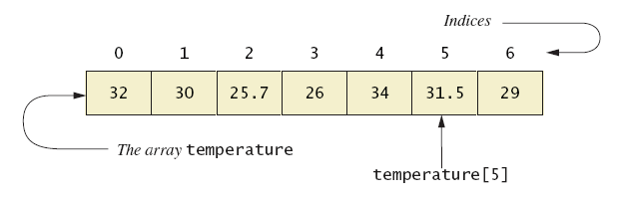
Creating and Accessing Arrays
A common way to visualize an array
double [] temperature = new double [7];
// Read temperatures and compute their average:
Scanner keyboard = new Scanner (System.in);
System.out.println ("Enter 7 temperatures:");
double sum = 0;
for (int index = 0 ; index < 7 ; index++){
temperature [index] = keyboard.nextDouble ();
sum = sum + temperature [index];
}
double average = sum / 7;

Slide 9
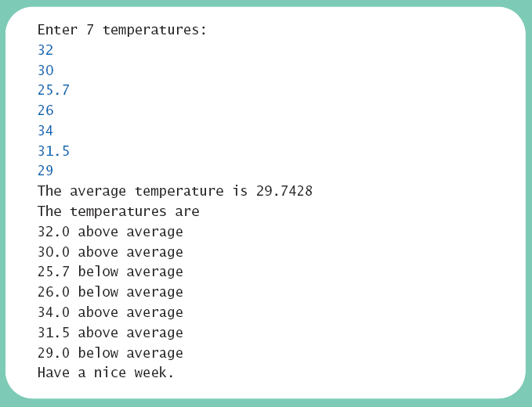
Creating and Accessing Arrays

Slide 10
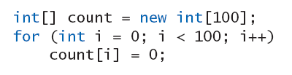
Initializing Arrays
Possible to initialize at declaration time
Also may use normal assignment statements
One at a time
In a loop

Slide 11
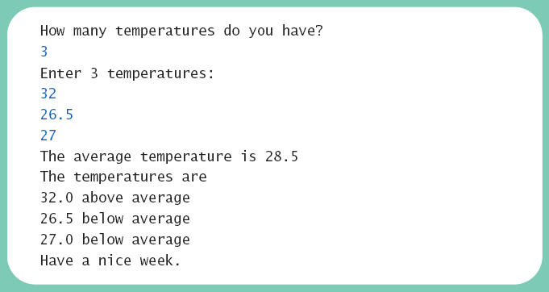
The Instance Variable length

Slide 12
Agenda
Array Basics
Arrays in Classes and Methods
Sorting Arrays
Multidimensional Arrays

Slide 13
Case Study: Sales Report
Program to generate a sales report
Associates (salesmen) that have the highest sales
How the sales of each associate compare to the average
Class will contain
Name
Sales figure (amount of sales)

Slide 14
Case Study: Sales Report
SalesReporter Class
Variables
private double highestSales;
private double averageSales;
private SalesAssociate[] team;
private int numberOfAssociates; //Same as team.length

Slide 15
Case Study: Sales Report
Main subtasks for our program
Get ready
Obtain the data
Compute some statistics (update instance variables)
averageSales, highestSales
Display the results

Slide 16
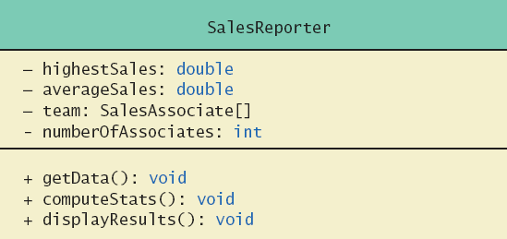
Case Study: Sales Report
Class diagram for class SalesReporter

Slide 17
Case Study: Sales Report
Class diagram for class SalesAssociate
SalesAssociate
- name: String - sales: double
+ setName(String name): void + setSales(double sales): void + getName(): String + getSales(): double

Slide 18
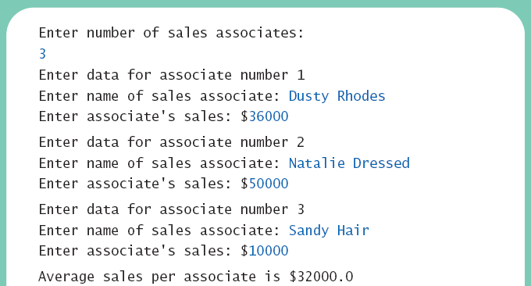
Case Study: Sales Report
class SalesReporter

Slide 19
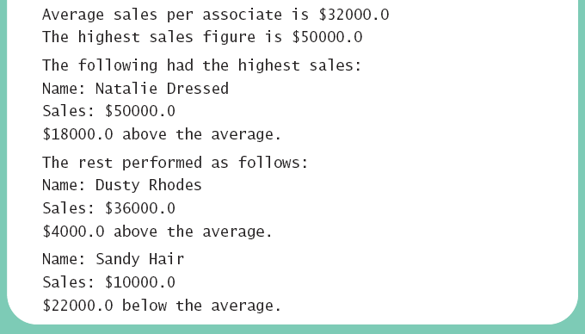
Case Study: Sales Report
class SalesReporter (2)

Slide 20
Indexed Variables as Method Arguments
Indexed variable of an array, such as a[i], can be used anywhere variable of array base type can be used.
public class ArgumentDemo {
public static void main (String [] args)
{
Scanner keyboard = new Scanner (System.in);
System.out.println ("Enter your score on exam 1:");
int firstScore = keyboard.nextInt ();
int [] nextScore = new int [3];
for (int i = 0 ; i < nextScore.length ; i++)
nextScore [i] = firstScore + 5 * i;
for (int i = 0 ; i < nextScore.length ; i++) {
double possibleAverage = getAverage (firstScore, nextScore [i]);
System.out.println ("If your score on exam 2 is " + nextScore [i]);
System.out.println ("your average will be " + possibleAverage);
}
}
public static double getAverage (int n1, int n2)
{
return (n1 + n2) / 2.0;
}
}

Slide 21
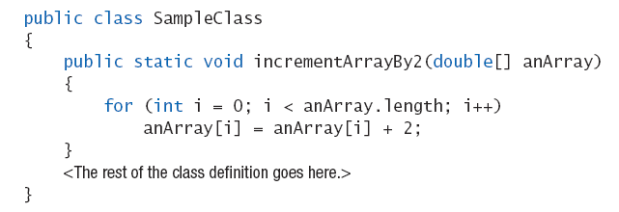
Entire Arrays as Arguments
Declaration of array parameter similar to how an array is declared
Ex)

Slide 22
Entire Arrays as Arguments
Array parameter in a method heading does not specify the length
An array of any length can be passed to the method.
Inside the method, elements of the array can be changed.
When you pass the entire array, do not use square brackets in the actual parameter

Slide 23
Arguments for Method main
Recall heading of method main
public static void main (String[ ] args)
This declares an array
Formal parameter named args
Its base type is String
Thus possible to pass to the run of a program multiple strings
These can then be used by the program.

Slide 24
Array Assignment and Equality
Arrays are objects
Assignment (=) vs. equality (==) operators.
Variable for the array object contains memory address of the object
Assignment operator = copies this address
Equality operator == tests whether two arrays are stored in same place (address) in memory
Remember array types are reference types

Slide 25
Methods that Return Arrays
A Java method may return an array
To return the array value
Declare a local array
Use that identifier in the return statement
public String[] getStudentNames() {
String[] studentNames = new String[2];
studentNames[0] = "JC Nam";
studentNames[0] = "JH Park";
return studentNames;
}

Slide 26
Agenda
Array Basics
Arrays in Classes and Methods
Sorting Arrays
Multidimensional Arrays

Slide 27
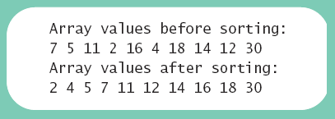
Selection Sort
Sorting: arranging all elements of an array so they are ascending (or descending) order
Selection sort
Algorithm is to step through the array
Place smallest element in index 0
Swap elements as needed to accomplish this

Slide 28
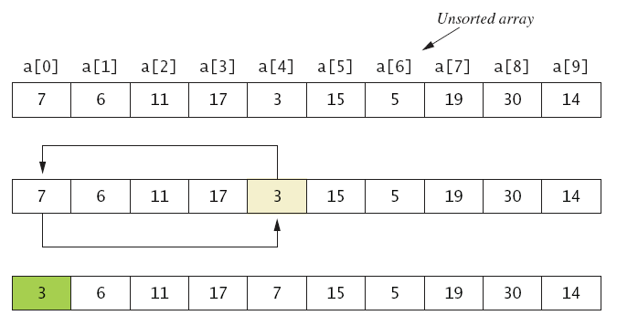
Selection Sort
Figure 7.5a

Slide 29
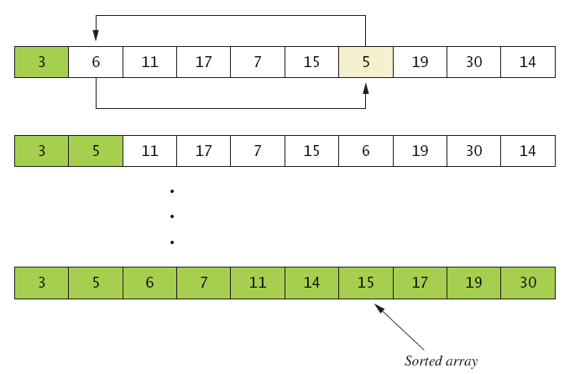
Selection Sort
Figure 7.5b
. . .

Slide 30
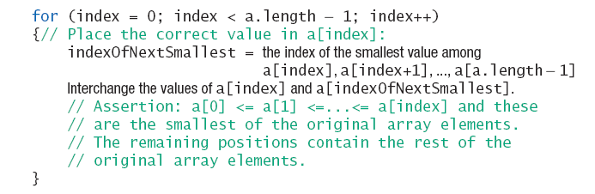
Selection Sort
Algorithm for selection sort of an array
See JC's implementation
https://github.com/lifove/SelectionSorting/blob/master/src/main/java/edu/handong/csee/java/array/sort/ArraySorter.java

Slide 31
Other Sorting Algorithms
Selection sort is simplest
But it is very inefficient for large arrays
Java Class Library provides for efficient sorting
Has a class called Arrays
Class has multiple versions of a sort method (static methods)
Ex) Arrays.sort(int[] a), Arrays.sort(double[] a), …
See http://java.oracle.com or
http://docs.oracle.com/javase/9/docs/api/java/util/Arrays.html

Slide 32
Agenda
Array Basics
Arrays in Classes and Methods
Sorting Arrays
Multidimensional Arrays

Slide 33
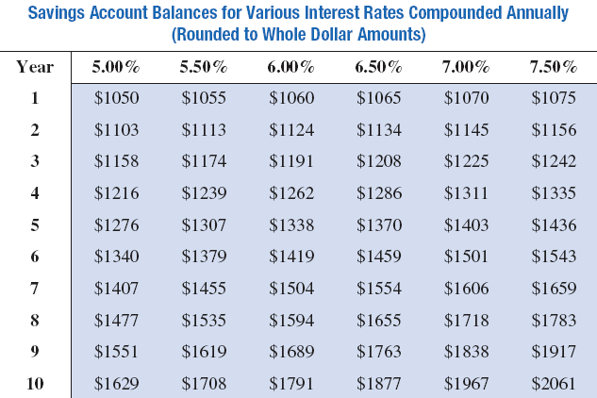
Multidimensional-Array Basics
A table of values
Ex) int [ ][ ] table = new int [10][6];

Slide 34
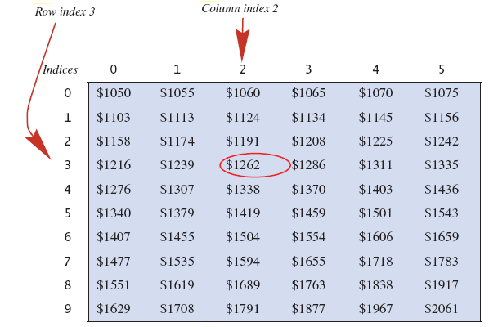
Multidimensional-Array Basics
Row and column indices for an array named table
table[3][2] has a value of 1262

Slide 35
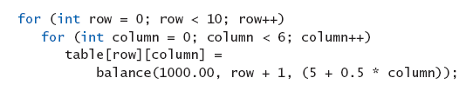
Multidimensional-Array Basics
We can access elements of the table with a nested for loop
Ex)

Slide 36
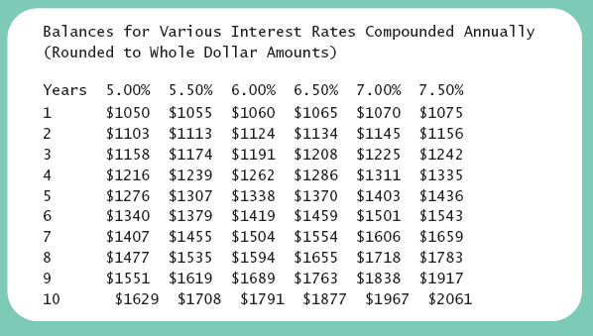
Multidimensional-Array Basics

Slide 37
Multidimensional-Array Parameters and Returned Values
Methods can have
Parameters that are multidimensional-arrays
Return values that are multidimensional-arrays

Slide 38
Java's Representation of Multidimensional Arrays
Multidimensional array represented as several one-dimensional arrays
Given int [ ][ ] table = new int[10][6];
Array table is actually 1 dimensional of type int[ ]
It is an array of arrays
Important when sequencing through multidimensional array

Slide 39
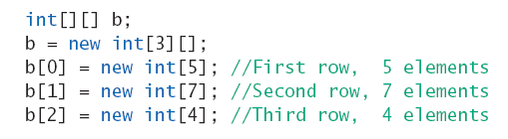
Ragged Arrays
Not necessary for all rows to be of the same length
Ex)

Slide 40
Programming Example
Employee Time Records
Two-dimensional array stores hours worked
For each employee
For each of 5 days of work week
Array is private instance variable of class
See the code from JC's GitHub
https://github.com/lifove/EmployeeTimeRecord/blob/master/src/main/java/edu/handong/csee/java/lecture/multidimensionalarray/TimeRecoder.java?ts=4

Slide 41
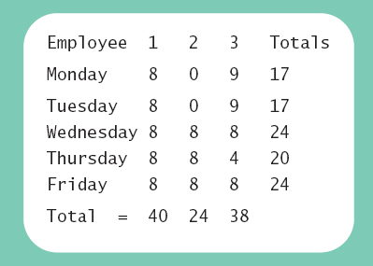
Programming Example

Slide 42
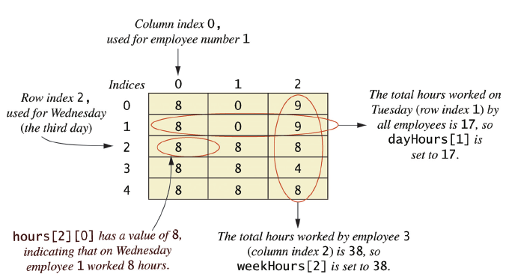
Programming Example
Arrays for the class TimeBook

